Slide 1
DSA DATA SET Case Study
Yasho Priya

Slide 2
Introduction:
The data is related with direct marketing campaigns of a European banking institution. The marketing campaigns were based on phone calls.
The consists of 41188 data points records with 20 inputs out of which 10 are numeric features and 10 are categorical features and the target variable is ‘ y - has the client subscribed a term deposit?’
The two classes are “yes” denoting that the customer subscribed to a term deposit, and “no” denoting that the customer did not subscribe.

Slide 3
Objective:
To find data patterns and clean the data for further modeling to help the organization, in advance, clients who will be receptive to such marketing campaigns.
The classification goal is to predict if the client will subscribe a term deposit (target variable y) and evaluate the performance with the existing model.
The performance metric used for this case study is AUC ROC score also known as AUROC (Area Under the Receiver Operating Characteristics).

Slide 4
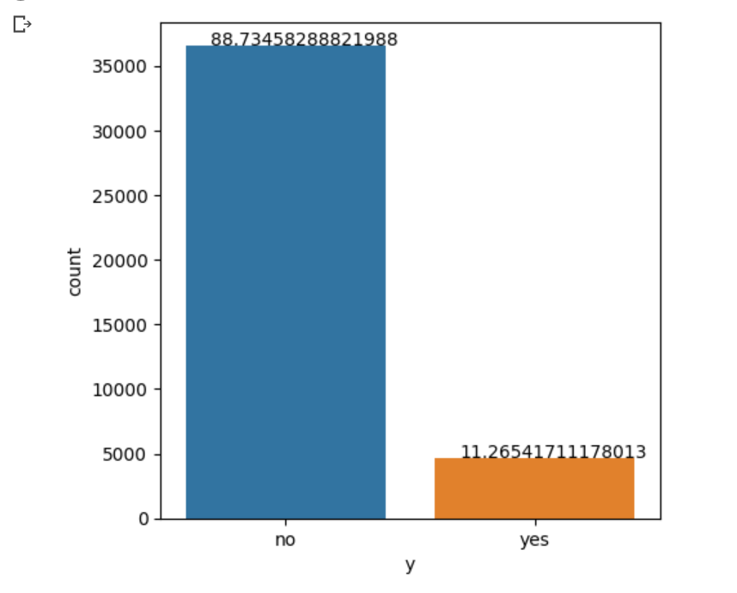
Exploratory Data Analysis:
EDA to find out more about what kind of data are we dealing with, if there is any pattern to the data.
From the above distribution we
see that the data is imbalanced,
as the number of “no’s” are also 8
times number of “yes”.

Slide 5
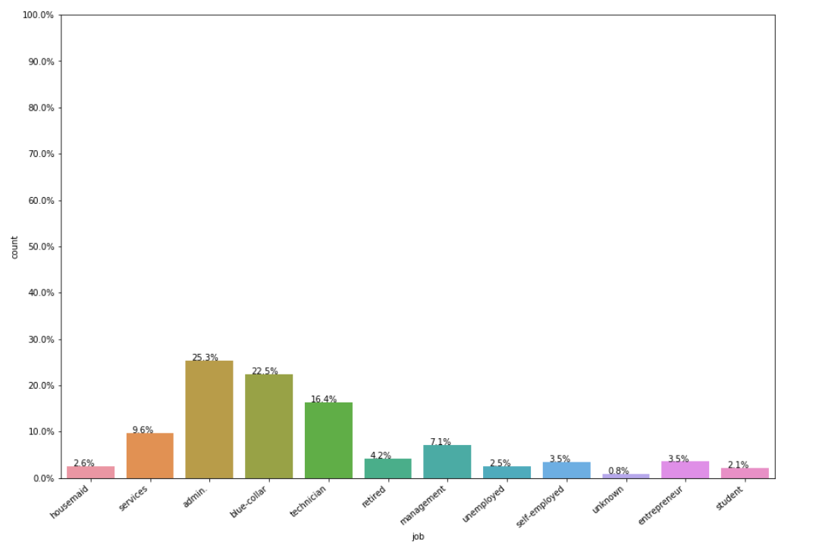
Variable: Job (Categorical variable)

Slide 6
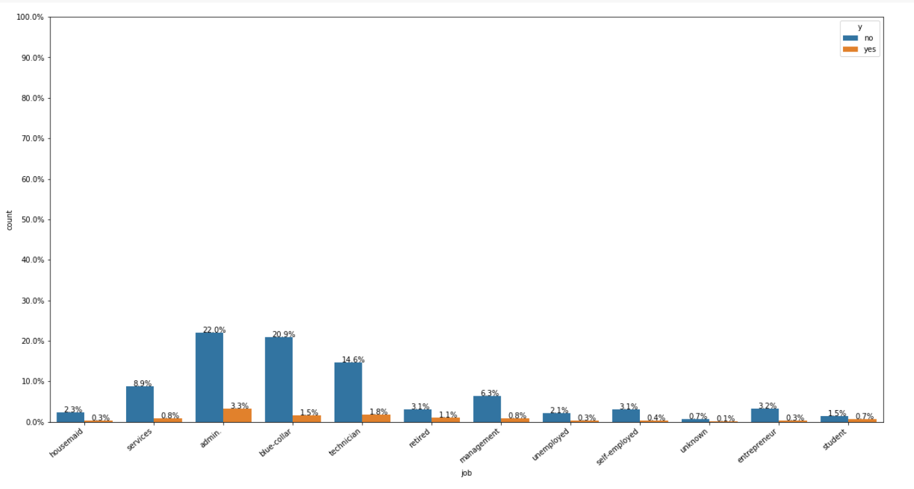
Which sectors customers have the highest rate of subscribing a term deposit ?

Slide 7
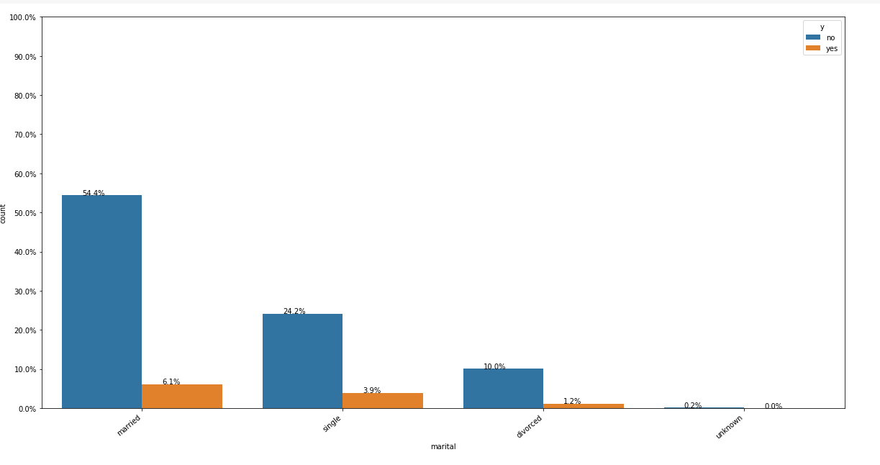
Customer’s marital status

Slide 8
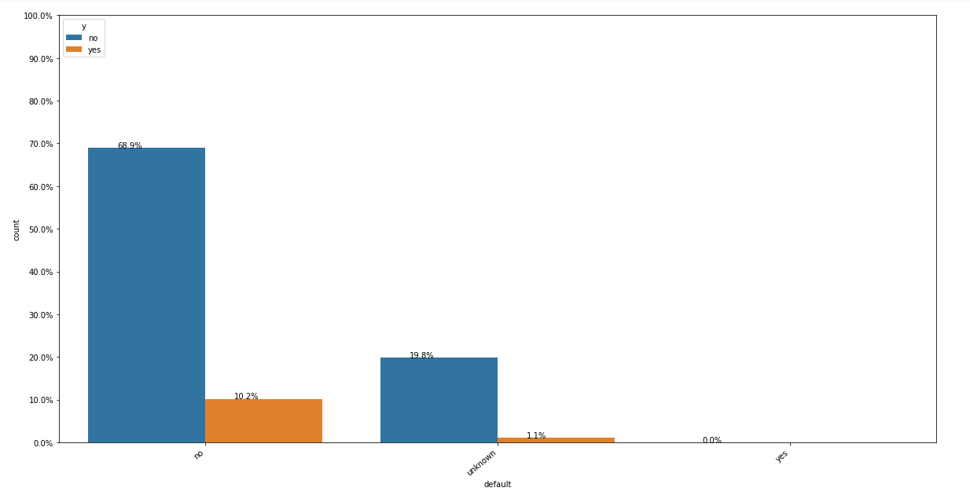
Customer has credit in default or not:

Slide 9
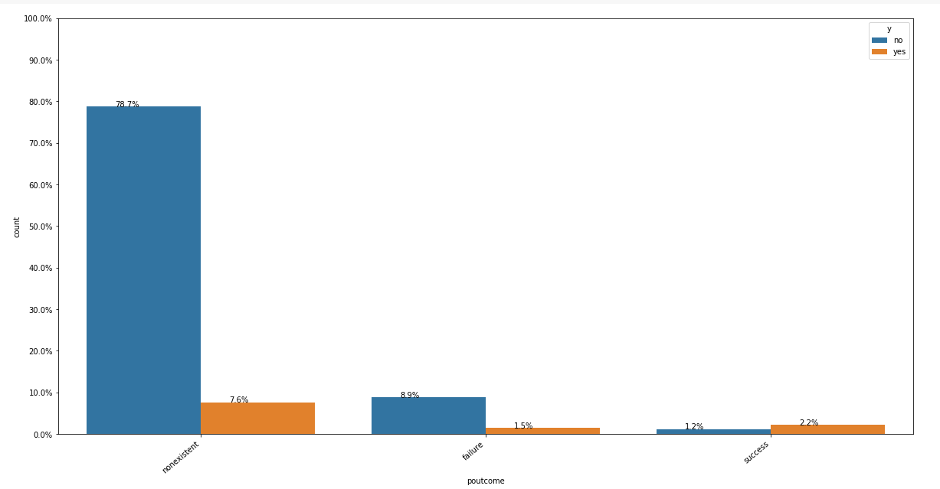
The outcome of the previous marketing campaign:

Slide 10
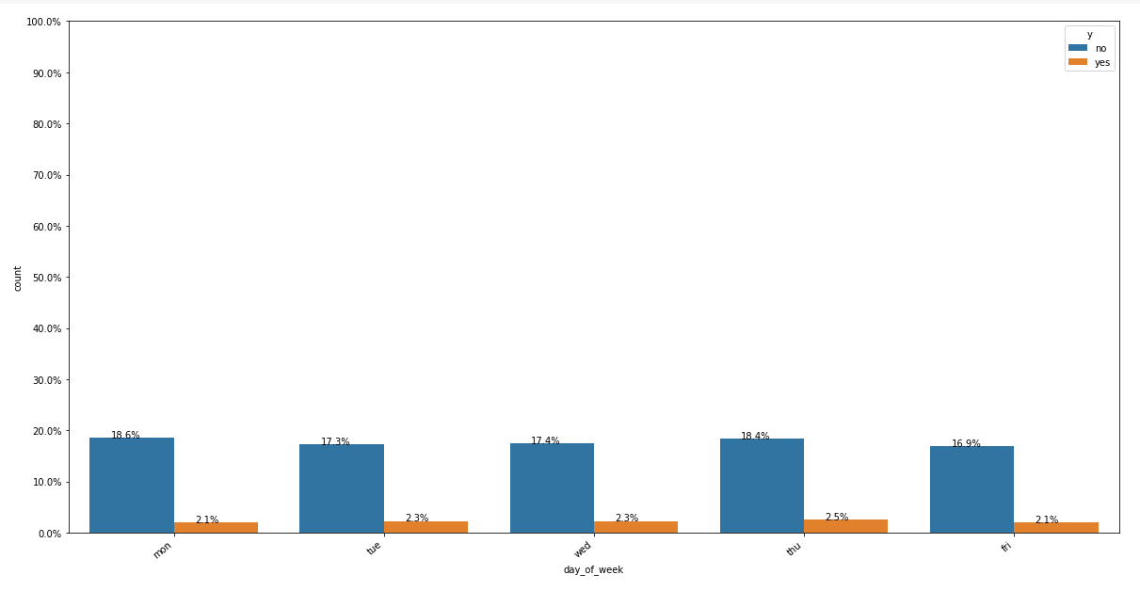
The last contact day of the week:

Slide 11
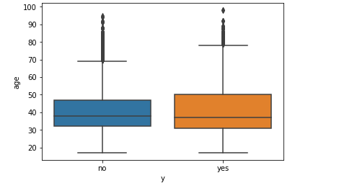
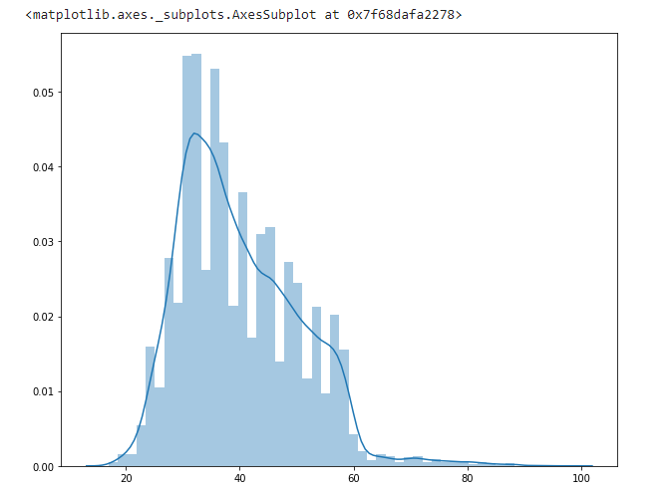
Univariate analysis on Numerical features
AGE :
The above boxplot shows both the customers that subscribed or didn’t subscribe a term deposit.

Slide 12
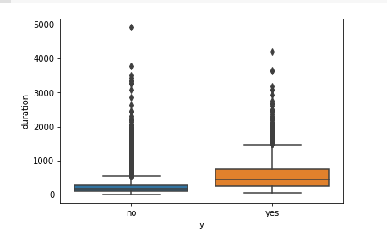
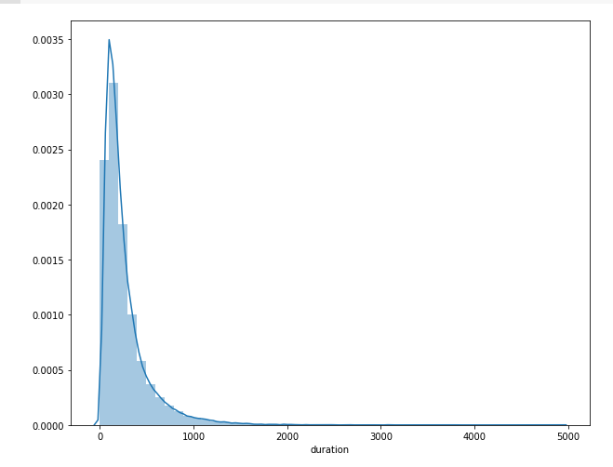
Duration:
The duration (last contact duration) of a customer can be useful for predicting the target variable.
This is like a power law distribution where most the values are very low and very few have high values.

Slide 13
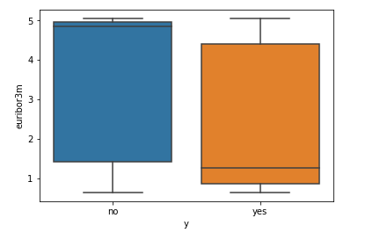
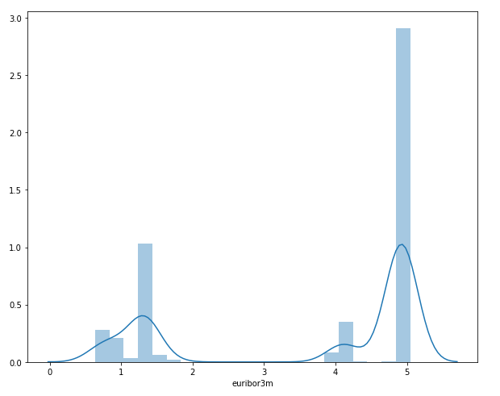
euribor3m:
The euribor denotes the basic rate of interest used in lending between banks in the market and used as a reference for setting the interest rate on other loans.

Slide 14
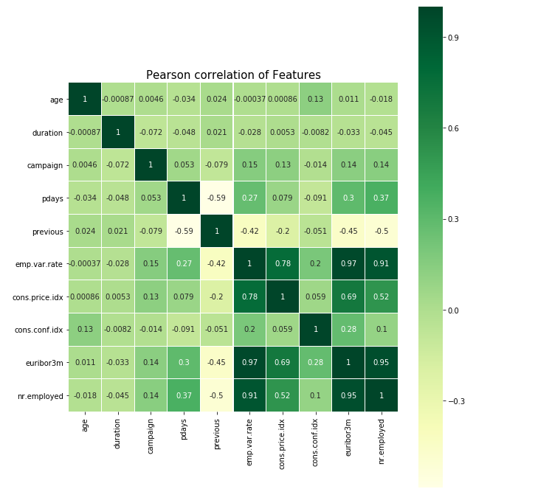
Correlation Matrix of the numerical features:
Correlation is a statistical measure that indicates the extent to which two or more variables fluctuate together.
The emp.var.rate, cons.price.idx, euribor3m and nr.employed features have very high correlation. With euribor3m and nr.employed having the highest correlation of 0.95.

Slide 15
Data Pre-Processing:
For this case study I will investigate two encoding schemes and compare the results of both the encoding schemes at the end of the case study. The two encoding schemes are:
One hot Encoding: This is one of the most popular encoding schemes to deal with the categorical features.
Response Coding: It is a technique to represent the categorical data while solving a machine learning classification problem. As part of this technique, we represent the probability of the data point belonging to a particular class given a category.
Splitting the data: It is very important to split your dataset into train, test and CV datasets, before applying any encoding schemes.

Slide 16
Predicting the target Variable:
Applied Random classification model on both the One hot encoded dataset and the Response coded dataset and compared the result.
In case of Random Forest, I have observed that even after hyper parameter tuning, the models are overfitting a lot with a train AUC of 1.0 and a test AUC of 0.94
Applied KNN classification model on both the One hot encoded dataset and the Response coded dataset and compared the result.

Slide 17
In the KNN classification model we can see the test AUC is 0.74 and the test AUC is 0.88.
Comparison:
Encoding | Model | Train AUC | Test AUC
One hot encoding | KNN | 0.949 | 0.925
 | Random forest | 1 | 0.945
Response coding | KNN | 0.881 | 0.74
 | Random Forest | 0.999 | 0.75

Slide 18
Conclusion:
Preprocessing was a very important step that helped in getting better accuracies. As some features contain important data as compared to others, every feature has to be preprocessed so that they are all in the same range and help in classification.
There were a lot of categorical variables and some numerical variables which capture various information about the customer and the bank-customer relationship.
The best classifier from the obtained results is the Random Forest Classifier. The RF classifier works well for imbalanced data set which can be proven from the obtained results.

Slide 19
After implementing all the models, we saw that the model that gave the best performance was Random forest test AUC was 1.0.
From the analysis we can see. After implementing all the models, the most important features or key attributes in predicting whether any customer will submit a term deposit are:
nr.employed
emp.var.rate
poutcome_success
Euribor3m

Slide 20
Thank you

